Slide 1
Lightning Inspired Search Algorithm
R07522630 機械碩一 賴雅晴

Slide 2
Reference
M. A. El Majdouli and A. A. El Imrani, "Lightning Inspired Search Algorithm: Introduction & application to the traveling salesman problem," 2015 10th International Conference on Intelligent Systems: Theories and Applications (SITA), Rabat, 2015, pp. 1-6.
Notes:
2015年發表的

Slide 3
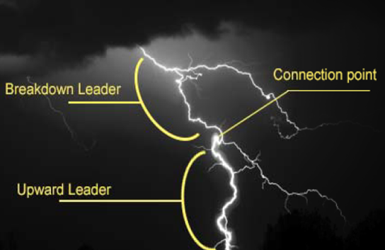


Basic Concept
Separate all particles into two subspace
→ Near cloud, Near ground
First phase : Breakdown leader propagation
Second phase : Upward leader propagation
Third phase : Stepped leaders’ connection
Notes:
這個演算法是模仿閃電從雲傳到地面的放電模式
閃電是連接大氣中的粒子傳下來的
把大氣中例子分成兩個部分
在NC產生下行先導

Slide 4

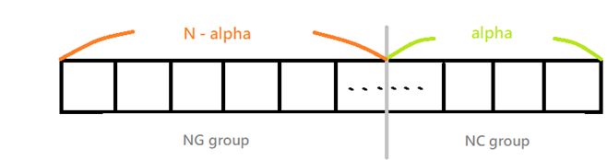
Basic Concept
The selection rules between the two constructions are different.
Local potential :
Consider a system with N particles representing a solution’s components ( path’s nodes ) .

Slide 5
Breakdown leader propagation
Although the initiation of the breakdown leader is still not well understood, many researchers suggest a simulating model of this propagation.
For the breakdown leader propagation on the NC group, particles with larger local potential are iteratively selected.
Notes:
在下行先導產生的模式科學家還沒有一個完整的解釋，但有一個大家通用的模擬模型
第一個先任意選
這篇paper propagation的方式是選局部電位最高的

Slide 6

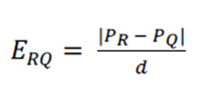
Upward leader propagation
Calculate E_{RQ}, the bigger the value of E_{RQ}, the bigger the probability for selecting the point Q.
As for the upward leader propagation on NG group, the selection is perform as follows :
R: the last added particle
Q: candidate particle
D: distance between R and Q
ß: random number between 0~1
Notes:
第一個先任意選

Slide 7
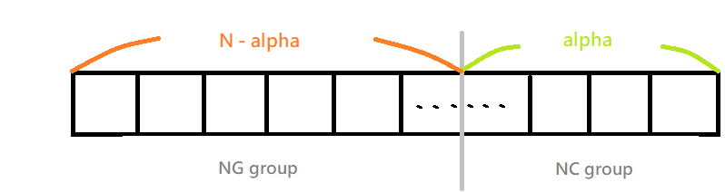

Stepped leaders’ connection
When each upward and breakdown leader are connected to form a complete lightning path, the connection allows us to obtain a solution.
C: charge amount
G(s) = discharge amount
f(s) = length of the lightning path

Slide 8
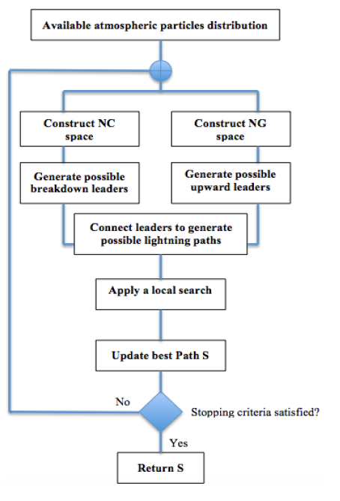

Slide 9
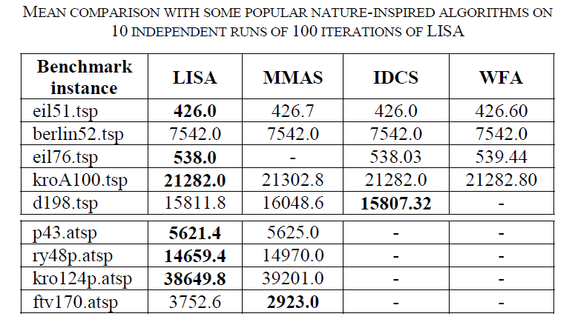
Conclusion
Min-Max
Ant
System
Discrete
Cuckoo
Search
Water
Flow-like
Algorithm

Slide 10
Thank You For Listening!

